Slide 1
A critical review of energy scenarios in Vietnam
VEAM 2019
A work by TRAN Hoang Anh (VIET/USTH) et al.
Presenter: NGUYEN Trinh Hoang Anh (VIET/USTH)
Vietnam Initiative for Energy Transition (VIET)
University of Science & Technology of Hanoi (USTH)
Dalat, 17 June 2019

Slide 2
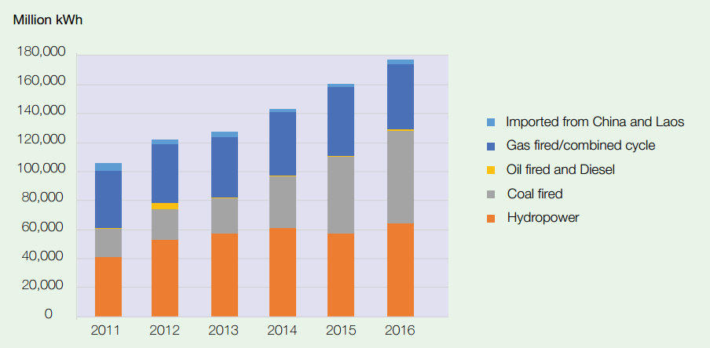
Current situation of Vietnam
Electricity generation
Important share of coal
Source: Vietnam Electricity Annual Report 2017 - EVN

Slide 3
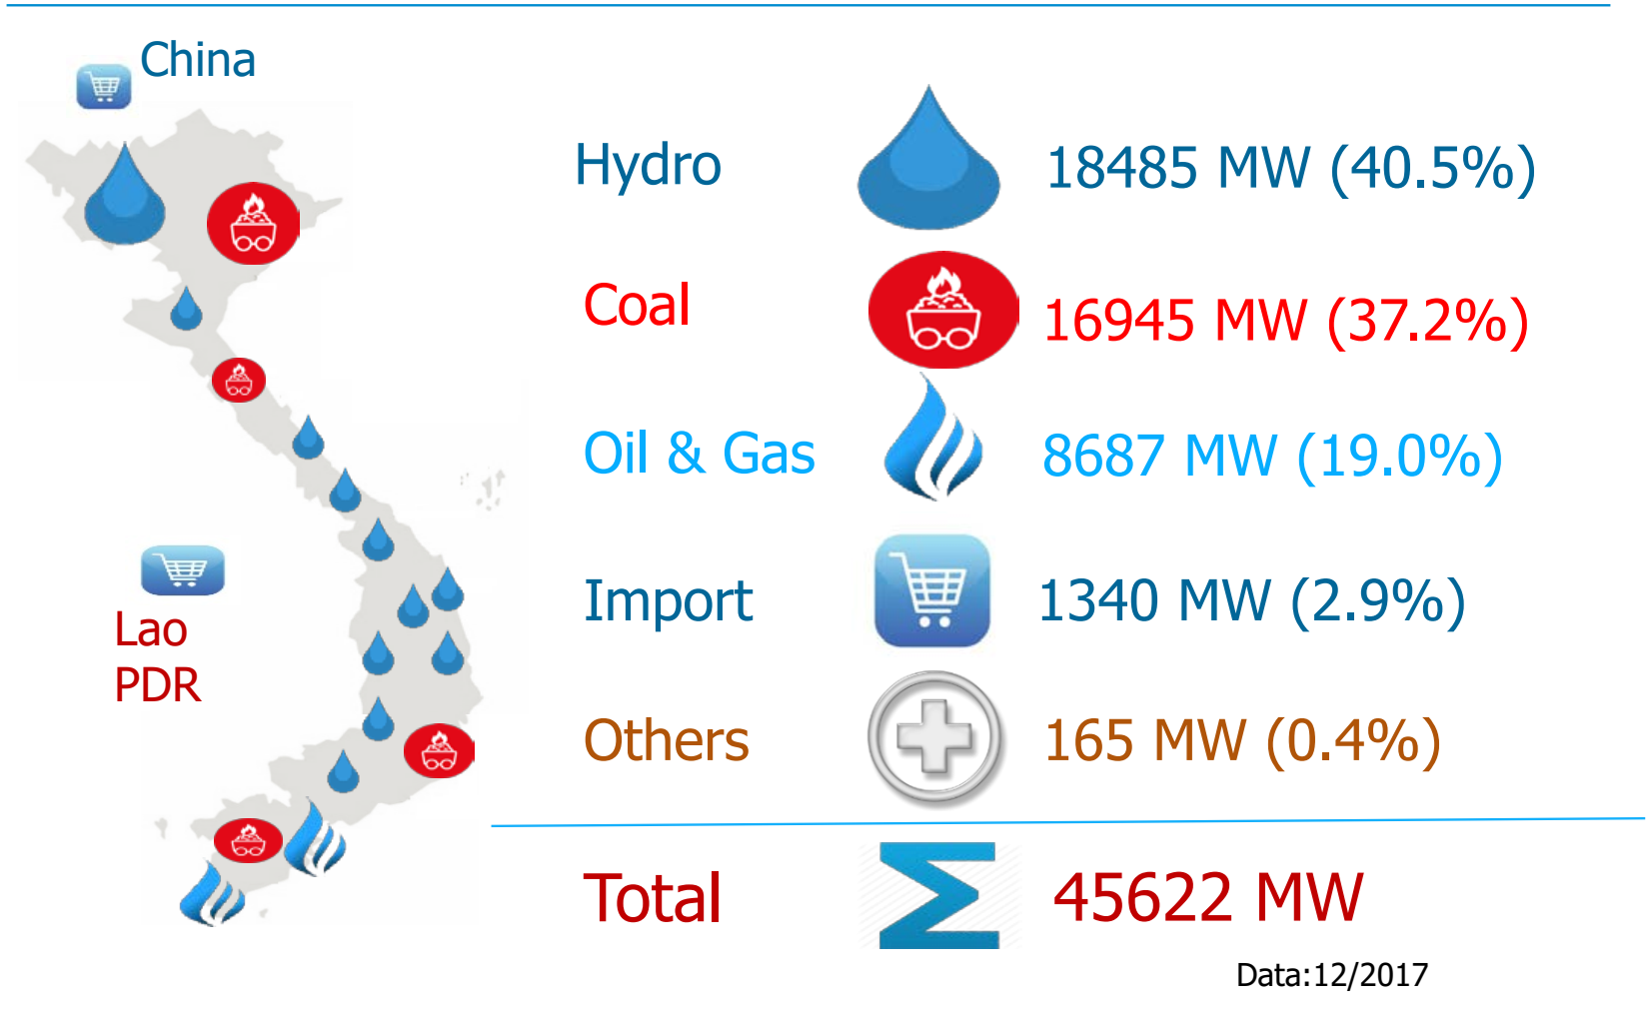
Installed capacity in 2017

Slide 4
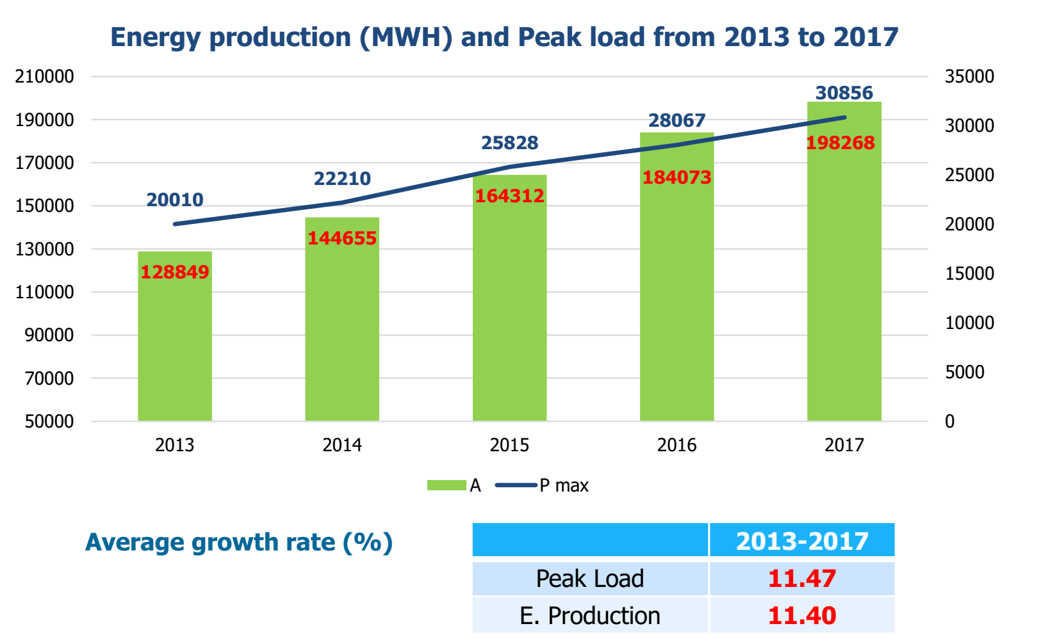

Slide 5
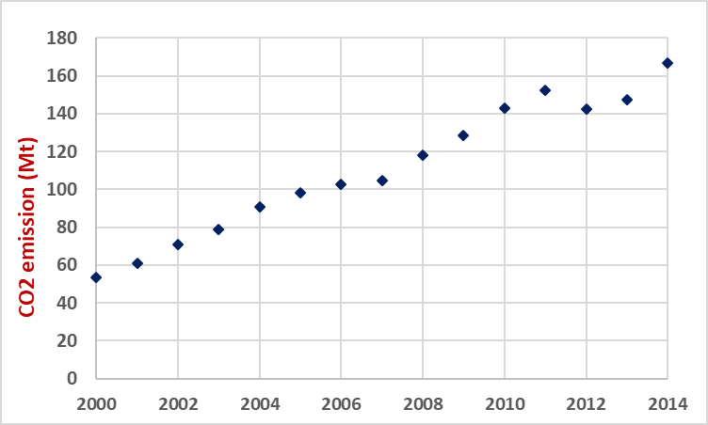
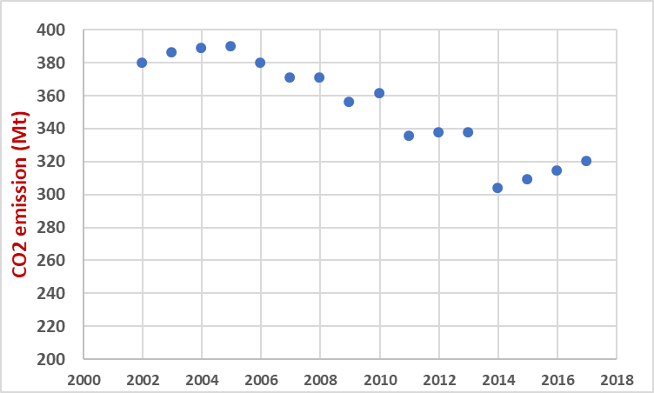
Current situation of Vietnam vs France
CO2 emission in Vietnam
CO2 emission in France
Increase 4 times from 2000 to 2014
Decreasing tendency from 2000 to 2017
Major commitment to nuclear energy
Source: World Bank
Source: https://www.statista.com/statistics/449698/co2-emissions-france/

Slide 6
Reviewed and comparision of energy studies
10 studies – 24 scenarios
PDP 7
REDS
PDP 7 Rev
2011
2015
2016
2017
2018
PDP = Power Development Plan
REDS = Renewable Energy Development Strategy

Slide 7
Indicators for the scenario comparison and data availabilities
N. | Report/ Scenarios | PDP 7 (2011) [2] | REDS (2015) [11] | PDP 7R (2016) [4] | IES (2016) [5] | WWF (2016) [12] | MOIT (2017) [13] | GreenID (2017) [7] | ADB (2017) [8] | Danish Energy Agency (2017) [9] | Decision Ware Group & IE (2018) [10]
 | Modelling tools |  |  | Simple-E STRATEGIST – PDPAT II PSS/ADAPT PSSE | Simple-E Corrective – Module 1 | PROPHET electricity planning | BALMOREL | MARKAL | EFFECT The computable general equilibrium (CGE) | BALMOREL | TIMES
 | Approach |  |  |  | Linear programming | Mixed integer programming Least cost investment | Top – down (Partial equilibrium) Least cost optimization | Bottom – up Least cost optimization | Bottom – up GHG emissions forecast model | Top – down (Partial equilibrium) Least cost optimization | Bottom – up Least cost optimization
A | Assumptions
A.1 | Population growth projections
A.2 | GDP growth
A.3 | Energy/power demand forecast
A.4 | Energy supply
A.5 | Energy efficiency
A.6 | Generation technology costs
A.7 | Fuels’ cost projections
A.8 | Energy policy assumptions | Electricity Law, Oil and Gas Law, Energy Efficiency Law, VNEEP, Coal/Gas Master Plan, RE Strategy | Renewable Energy strategies, Power Master plan | Electricity Law, Oil and Gas Law, Energy Efficiency Law, Energy Strategy to 2050, VNEEP, Coal/Gas Master Plan, RE Strategy | Electricity Law, Oil and Gas Law, Energy Efficiency Law, Energy Strategy to 2050, VNEEP, Coal/Gas Master Plan, RE Strategy | Renewable Energy strategies, Power Master plan, Energy efficiency program | Electricity Law, Oil and Gas Law, Energy Efficiency Law, Energy Strategy to 2050, VNEEP, Coal/Gas Master Plan, RE Strategy | Renewable Energy strategies, Power Master plan, Energy efficiency program | Low carbon policy, GHG emission, NDC target, green growth policies | RE strategy, Carbon price (average and high), Carbon cap, no coal | VNEEP, Coal/Gas Master Plan, RE Strategy, NDC-2 Review and Update of Viet Nam's Nationally Determined Contribution for Energy Sector
A.9 | Carbon price
A.10 | Scale (national, regional) | Regional and National | National | Regional and National | National | National | National | Regional | National | National | Regional and National
R | Simulation results
R.1 | (Total) Generation mix/ Capacity mix
R.2 | Installed coal capacity (in 2030)
R.3 | Coal share/import
R.4 | CO₂ emissions
R.5 | LCOE
R.6 | Reserve margin
R.7 | Renewable energy share
R.8 | Total investment cost

Slide 8
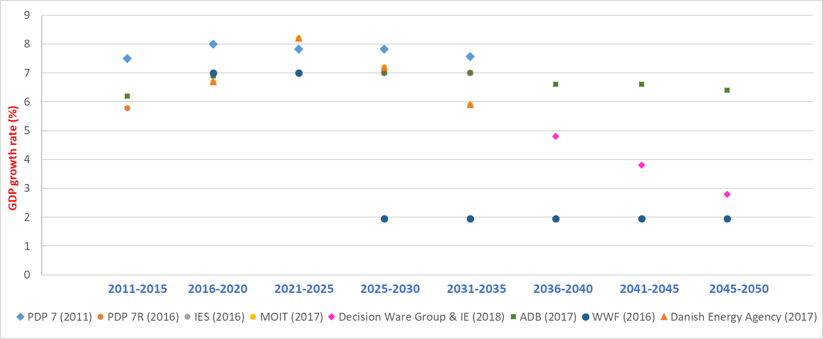
Population growth rate of Vietnam

Slide 9
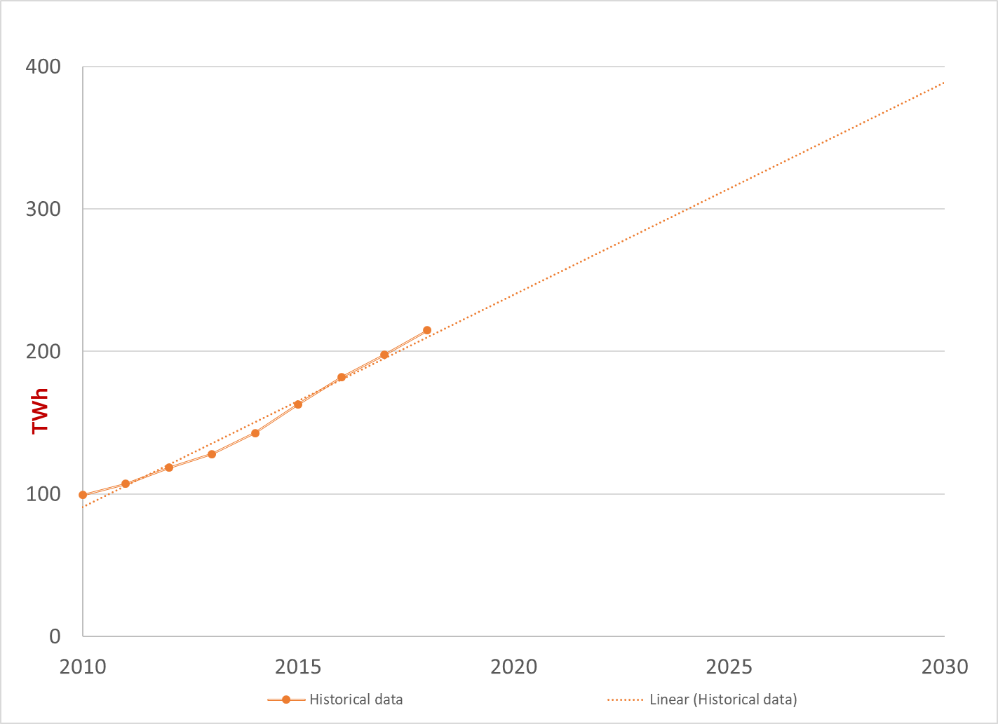
Back - casting of Power demand of Vietnam
Historical Power Demand

Slide 10
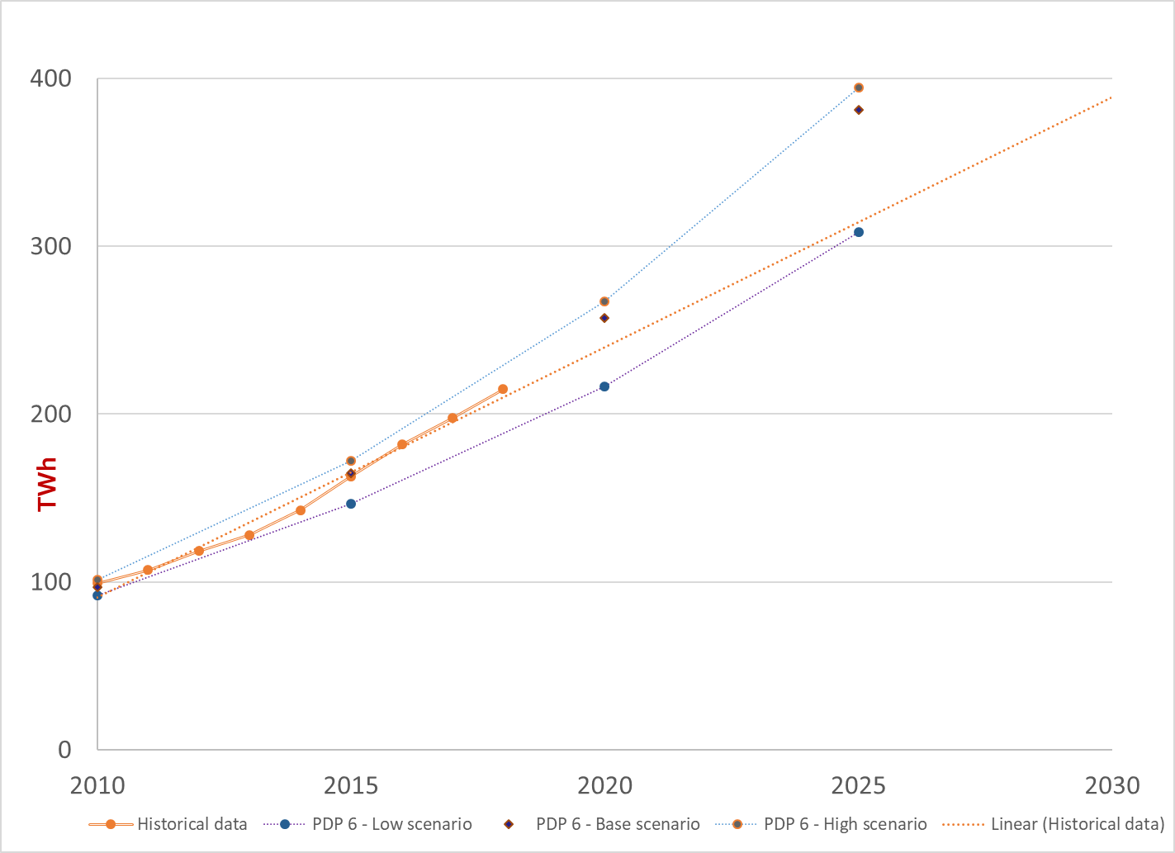
Back - casting of Power demand of Vietnam
Power development plan VI

Slide 11
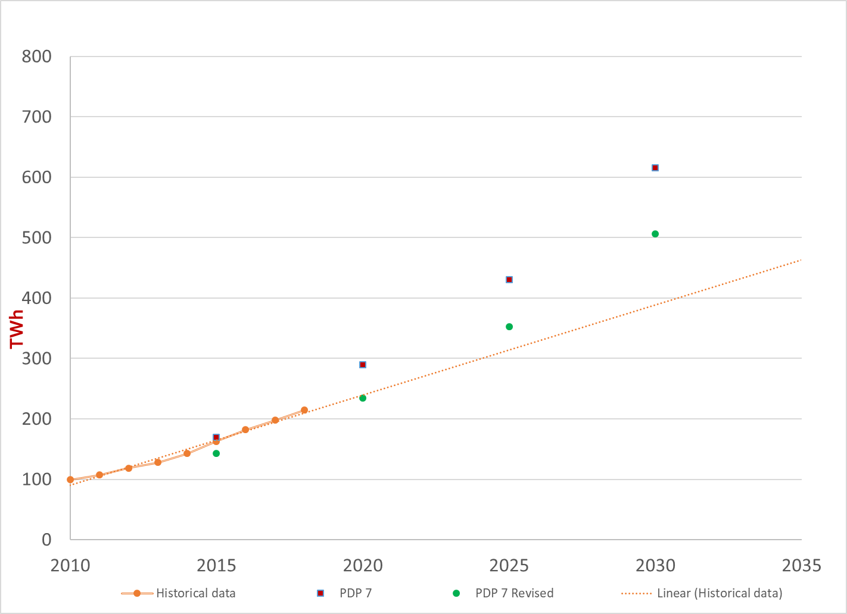
Back - casting of Power demand of Vietnam
Power development plans VII and VII Rev.

Slide 12
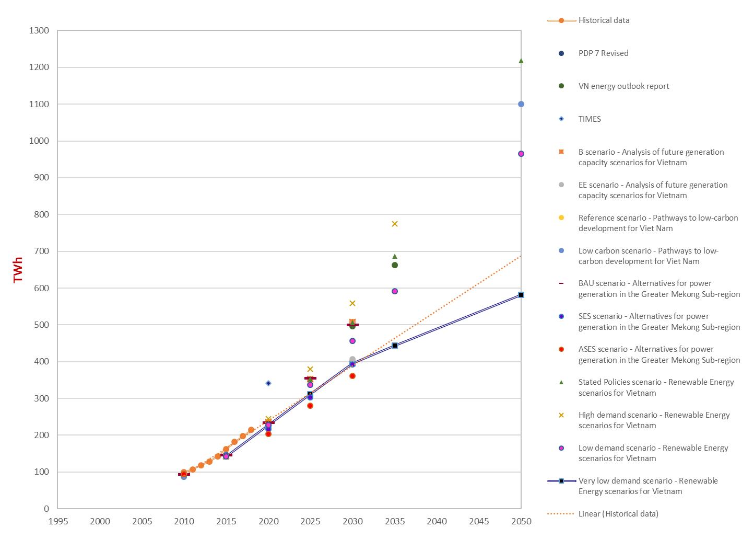
Comparison of Power demand projection
Other scenarios

Slide 13
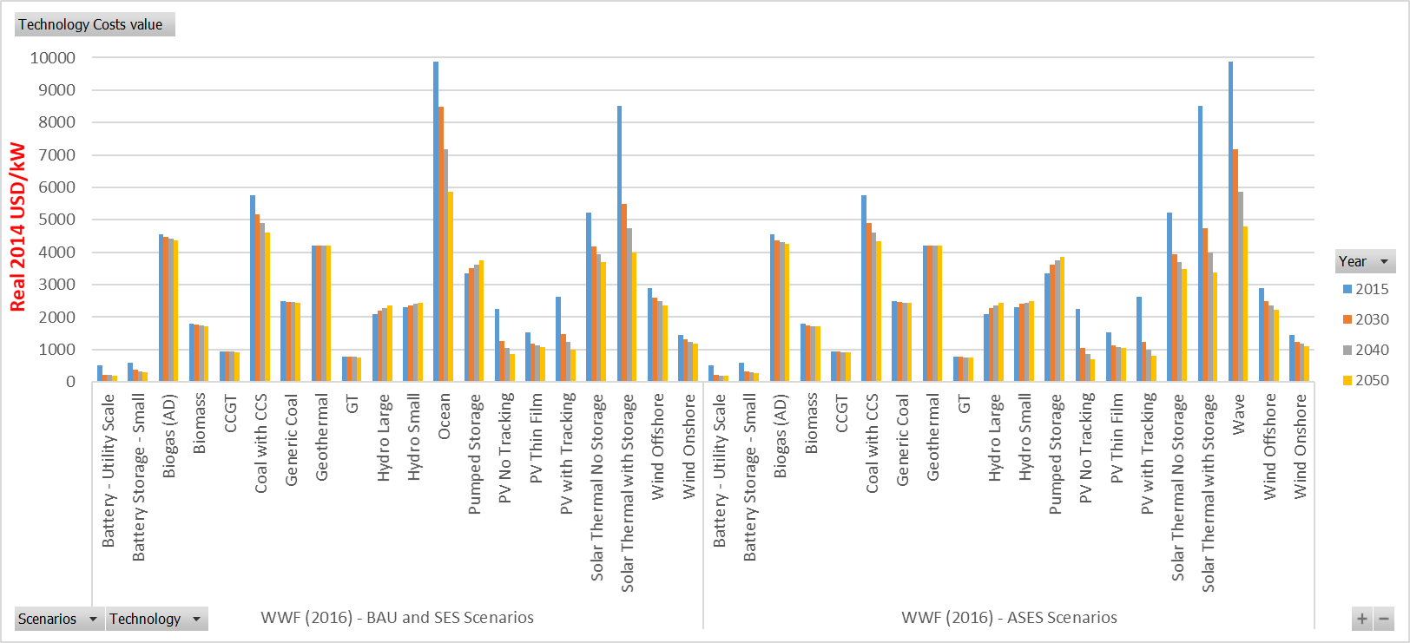
Costs of electricity generation technologies

Slide 14
Energy Models used in the scenarios reviewed

Slide 15
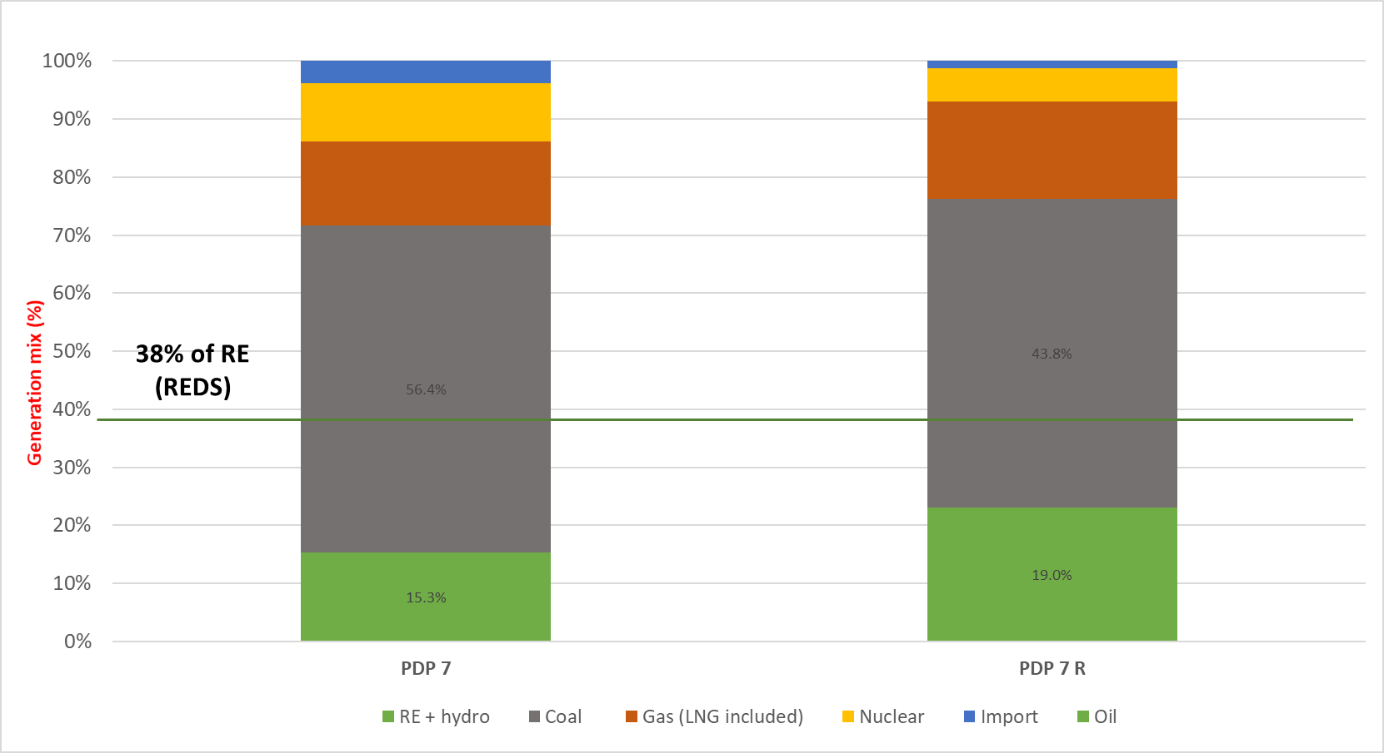
Comparison of Generation mix in 2030

Slide 16
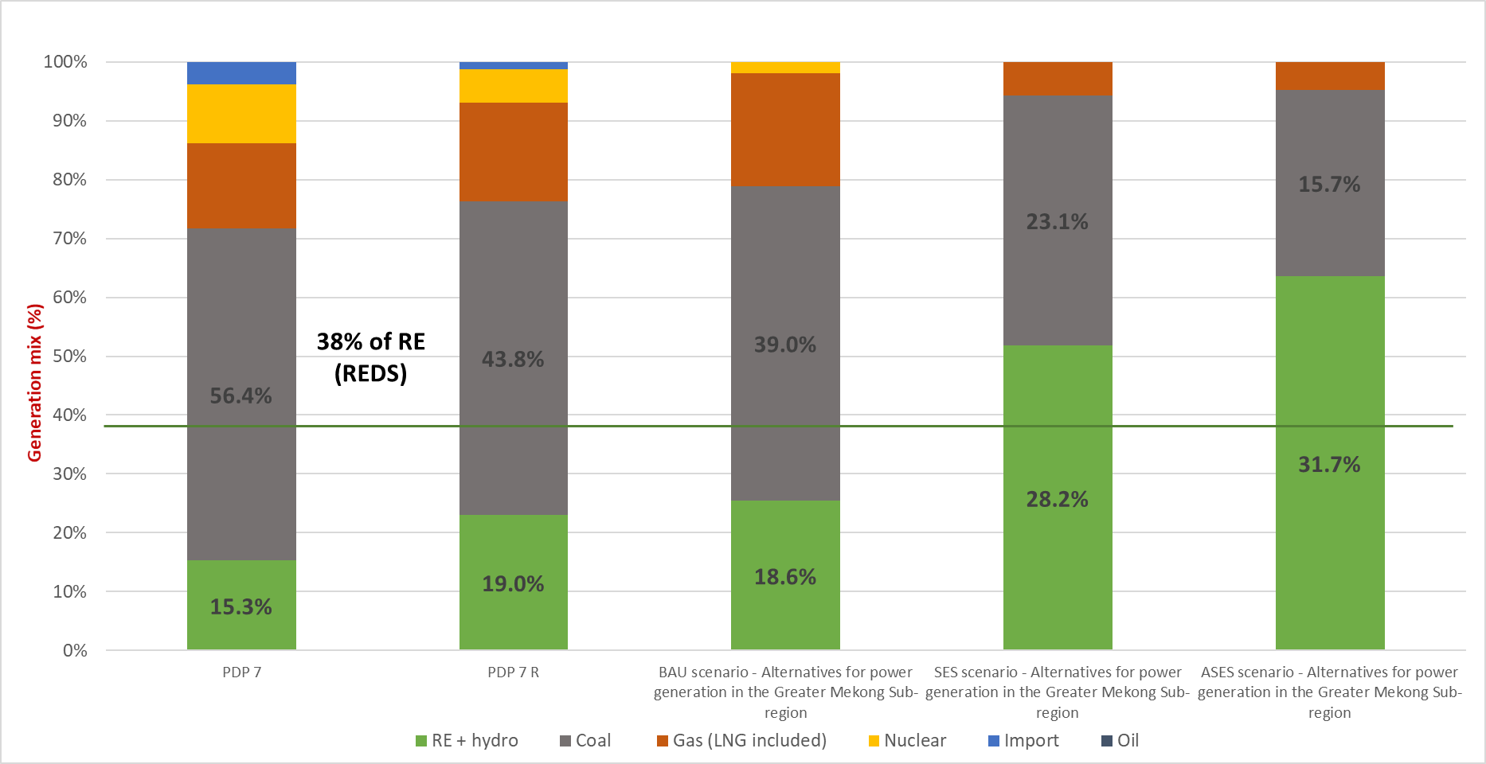
Comparison of Generation mix in 2030

Slide 17
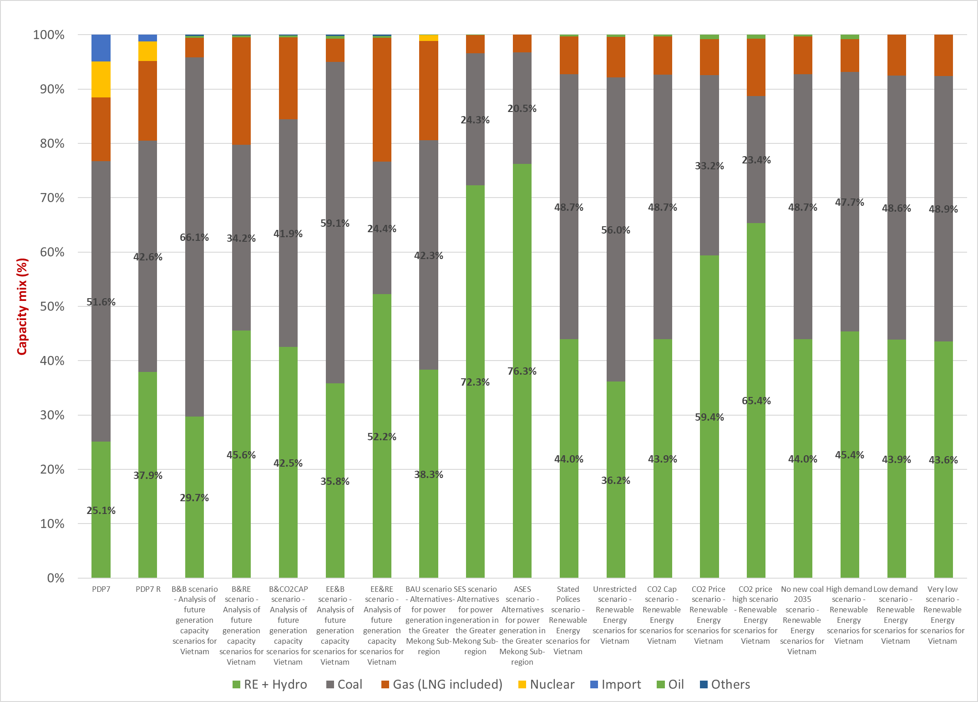
Comparison of Capacity mix in 2030

Slide 18
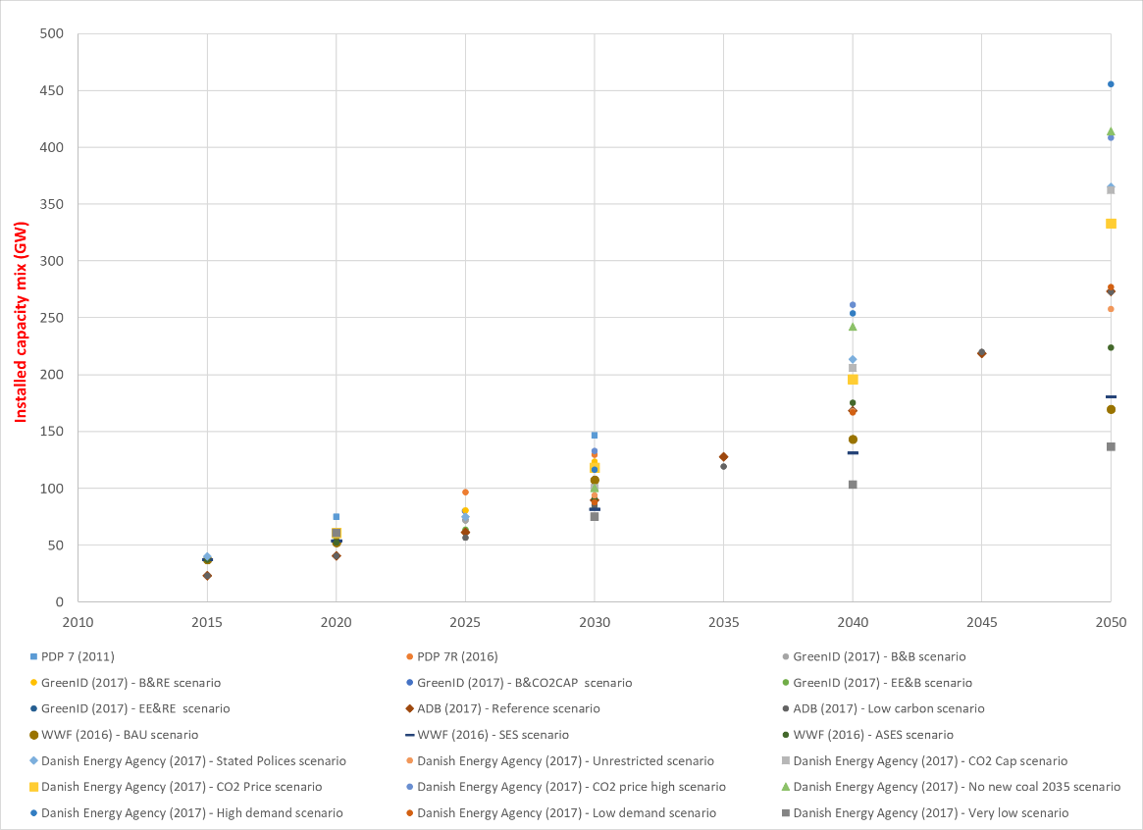
Installed power capacity

Slide 19
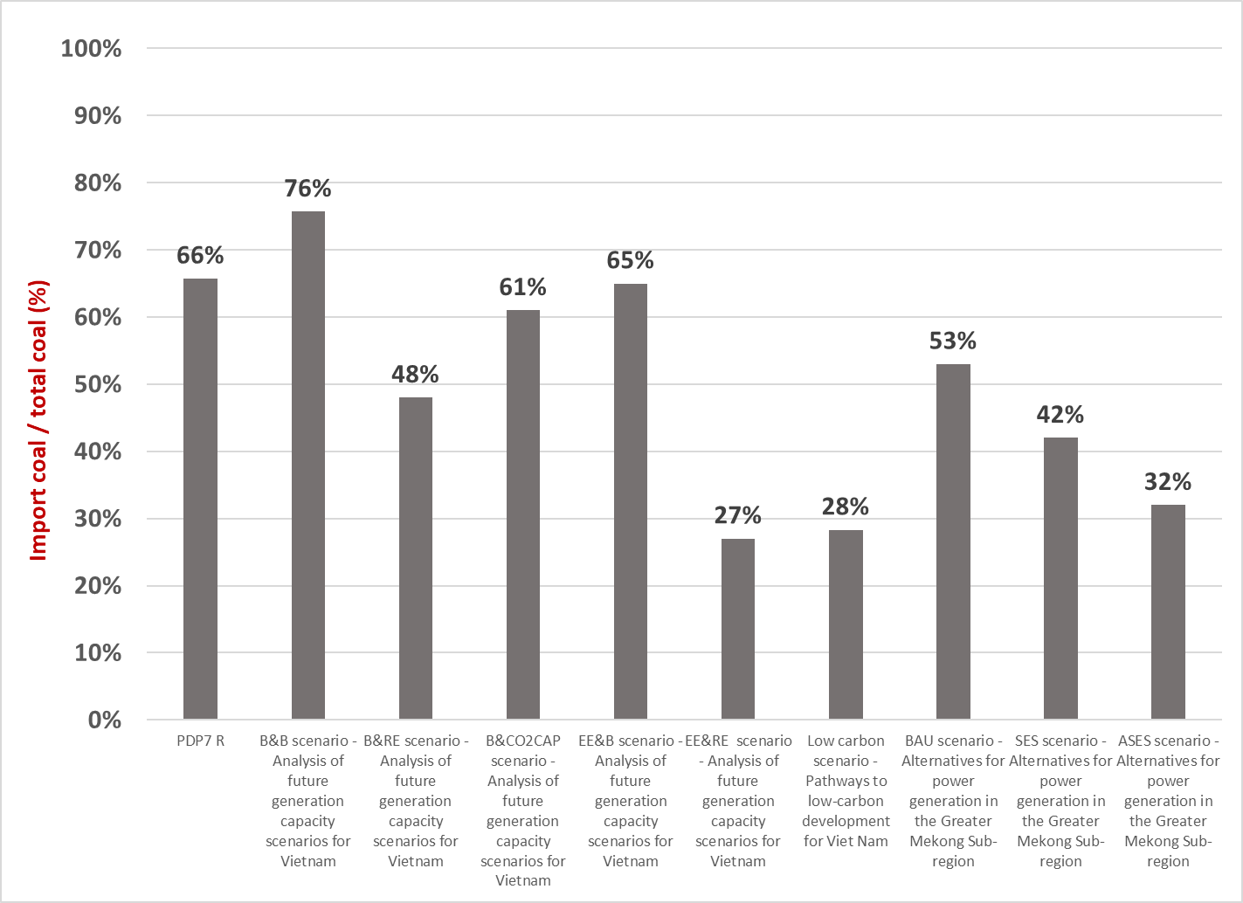
Comparison of the share of coal in 2030
More renewable energies and energy efficiency strategy provide solution to import less coal

Slide 20
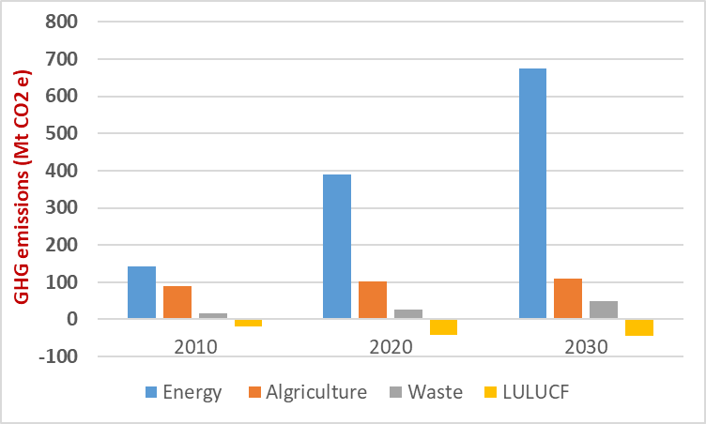
Comparison of CO2 emissions
Vietnam NDC 1
GHG emissions in 2030
787.4 Mt CO2 e
From Energy sector
675.4 Mt CO2 e
Domestic support
645.9 Mt CO2 e
International support
638.9 Mt CO2 e
Source: Viet Nam’s Intended Nationally Determined Contribution

Slide 21
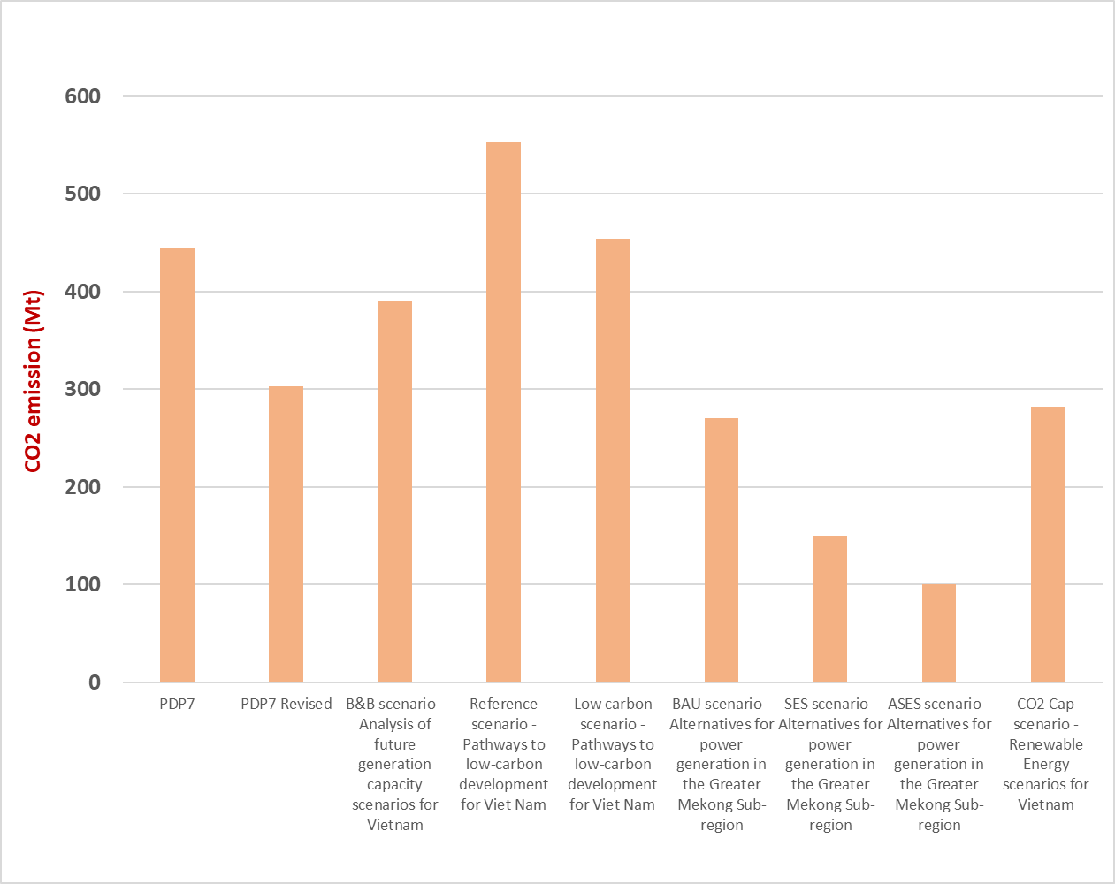
Comparison of CO2 emissions in 2030

Slide 22
Carbon’s price
For carbon’s price, most of scenarios based on the price proposed the estimated CO₂ externality value in Vietnam: 7 USD/ton for near term projection and 20 USD/ton thereafter for long term projection S
Some exceptional cases are: (i) 20 USD/ton was set for the whole modelled period by WWF (2016) scenarios [6], or (ii) 35 USSD/ton (taken from IMF 2014 source) in the GreenID (2017) study [7], or
(iii) Danish Energy Agency (2017) – CO₂ price high scenarios investigated to an ambitious environmental policies by imposing the most highest CO₂ price: the starting price at 20 USD/ton in 2020, achieving 45 USD/ton in 2035 and being constant until 2050.

Slide 23
Conclusion
High dependency on non-renewable fuel such as crude oil, natural gas and coal as sources of energy (53 GW from coal power plants in 2030 – PDP7 rev) from official power development plans. Other alternatives provide brighter perspectives
It is possible for Vietnam to achieve the commitment of the government to reduce 8% and 25% of GHG emissions without and with international supports, if Vietnam goes for green scenarios
Renewable energies are not yet utilized to their maximum potential in Vietnam due to high costs and insufficient market conditions
Challenges for energy transitions: RE grid integration, investment for clean power generation, soci0-economic and environmental impacts, etc.

Slide 24
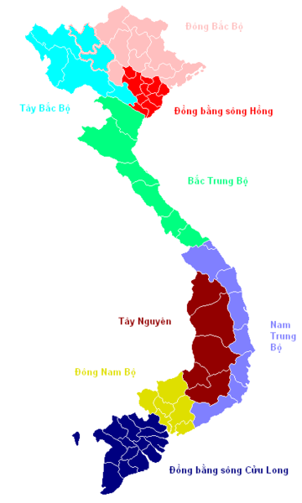
Thank you for your attention

